Slide 1
ED Musculoskeletal Radiology (MSK)
Notes:
40 minutes:
10 min intro lecture
30 min cases

Slide 2
Outline
Types of MSK problems encountered in the ED
Modalities used
Ordering and reading MSK plain films
Cases

Slide 3
MSK Problems Seen in the ED
TRAUMA
  Fractures
  Dislocations
  Sprains/Strains
Pain
  Acute (Trauma)
  Chronic (arthritis, etc.)
Infection
  Septic arthritis
  Cellulitis/abscesses
Notes:
Not an exhaustive list, but covers the most commonly encountered categories

Slide 4
Modalities used in the ED
Plain films (x-rays)
Computed tomography (CT)
Magnetic resonance imaging (MRI)
Ultrasound

Slide 5
Ordering and Reading MSK Plain Films
“One view is no view”
Fracture or dislocation seen on only one view is REAL, but not seeing it on only one view doesn’t rule it out
Learn the views for major joints/bones
  Long bones: 2-views (AP and lateral)
  Joints: 3-views
    Shoulder: IR, ER, and Axillary
    Knee: AP, lateral, and tunnel or sunrise depending on suspected pathology
    Ankle: AP, lateral, mortise

Slide 6
Ordering and Reading MSK Plain Films
Long bones
  Follow the cortex all the way around on every bone
    Look for step-offs and abrupt contour changes
  Pay attention to the trabecular patterns
    Look for disruptions or density changes due to impaction
Intra-articular
  Look for an effusion
    “Fluid-fluid” line is a lipohemarthrosis and is
    pathognomonic for an intraarticular fracture

Slide 7
Ordering and Reading MSK Plain Films
Know fracture patterns to guide your eye
  Don Juan fracture
    Calcaneus fracture + spine fracture (burst)
  Dashboard injury
    Patella fracture + posterior hip dislocation + posterior wall tab fx
  Maisonneuve fracture
    Ankle syndesmosis injury + proximal 1/3 spiral fibula fracture
If you aren’t sure:
  Image the joint above and below a fracture
  Where’s there is one, there is usually more
Notes:
Just some examples to make the point. There are obviously many more.

Slide 8
Ordering and Reading MSK Plain Films
When all else fails…
  Remember that most people have a matched pair
  Image the contralateral side and look for differences

Slide 9
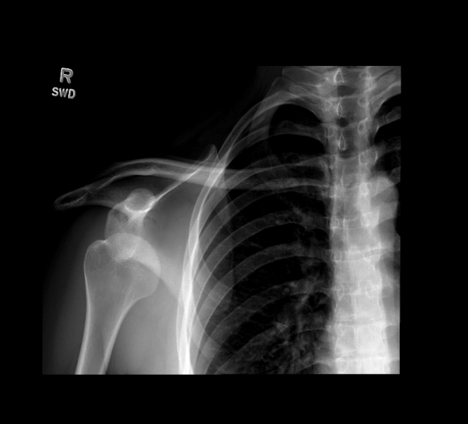
Case 1

Slide 10
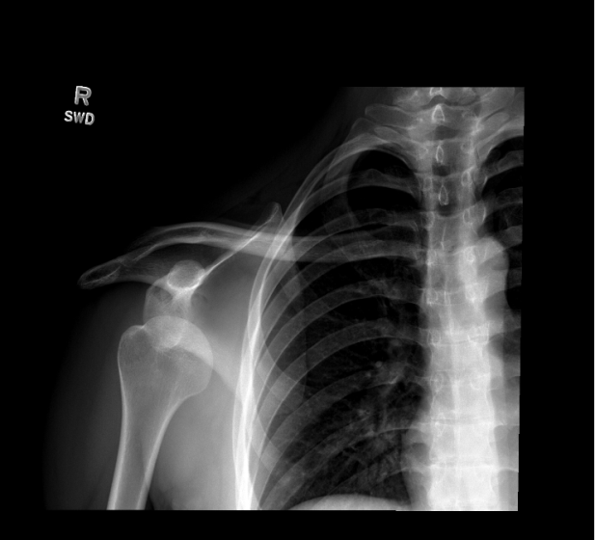

Slide 11
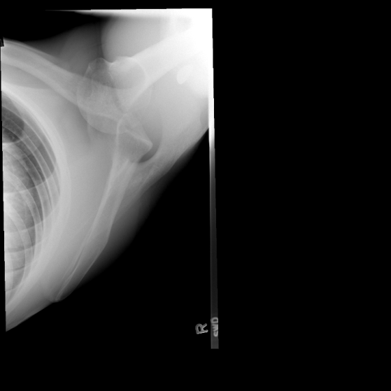
Notes:
Anterior shoulder dislocation
- Glenohumeral (shoulder) dislocations are classified by the direction the humeral head moves relative to the glenoid. Anterior are the most common, followed by posterior, and finally inferior are the most rare.
- Anterior dislocations are caused by forced external rotation of the humerus, usually traumatic.
- Posterior dislocation are caused by forced internal rotation of the humerus, such as by massive activation of the pectoralis muscles (internal rotators) by seizure or electrocution.
- Inferior dislocations are caused by traumatic forceful abduction of the arm, such as falling through a roof. This is also known as luxatio erecta and the patient will present as though they have a question to ask.
- It is difficult and problematic to try to differentiate anterior and posterior dislocations on frontal views only. The ideal view is an axillary view. Look for the coracoid process (“lighthouse of the shoulder”) to determine the anterior orientation. If the humeral head is dislocated toward the coracoid process, it is an anterior dislocation. If it is dislocated away from the coracoid process, it is a posterior dislocation.

Slide 12
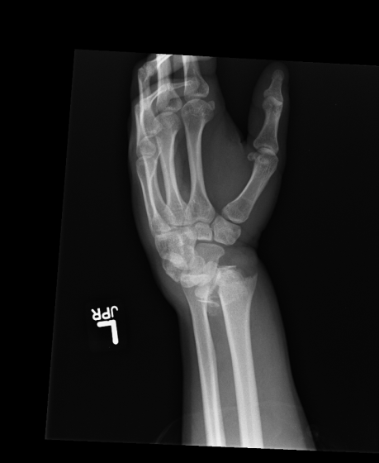
Case 2

Slide 13
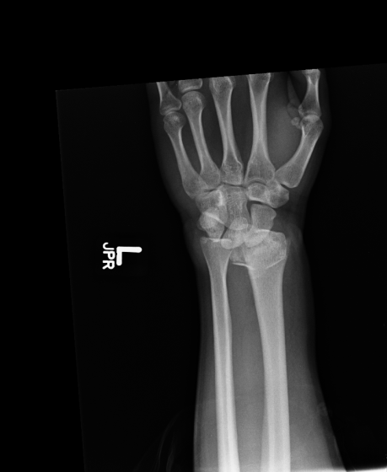

Slide 14
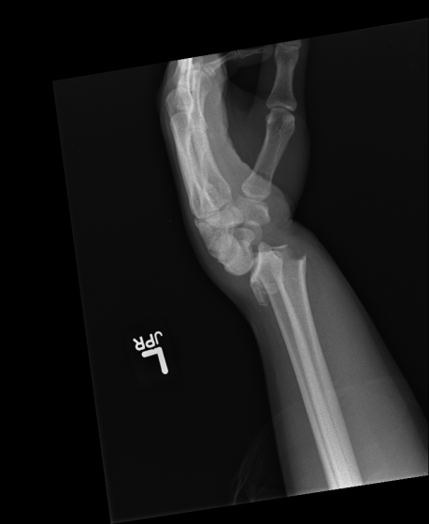
Notes:
Colles fracture (dorsally displaced/angulated distal radius fracture)
- Mechanism of injury determines the direction of displacement in a distal radius fracture. The fall on outstretched hand (FOOSH) is the most common mechanism and results in a dorsal displaced/angulated fracture (Colles). A fall against a flexed wrist may result in a volar displaced/angulated fracture (Smith). Both fractures are extraarticular, meaning the fracture lines do not extend to the radiocarpal joint surface.
- The Colles fracture has a characteristic deformity on physical exam, called the Dinner Fork deformity. This can also be seen on lateral plain film imaging.

Slide 15
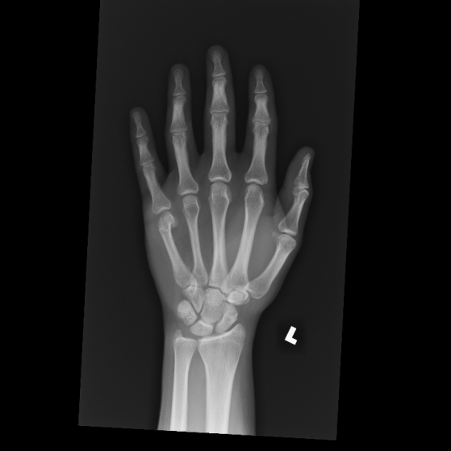
Case 3

Slide 16
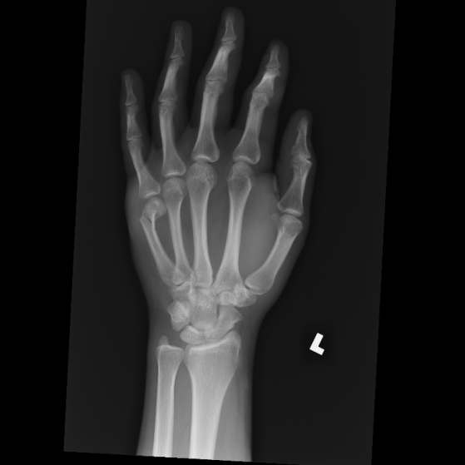

Slide 17
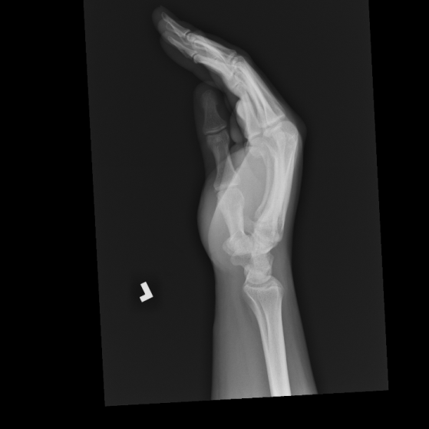
Notes:
5th metacarpal neck fracture with volar angulation (Boxer’s fracture)
- Boxer’s fractures are sustained from closed-fist strikes with the ulnar side of the fist. The relatively weaker metacarpals on this side of the hand break and angulate volarly from the deforming force of the closed-fist.
- Boxing is a relatively uncommon etiology now. More commonly seen are disgruntled individuals punching inanimate objects, such as walls.
- The decision to operate is based on angulation and rotation. Up to 50-60 degrees of angulation can be tolerated. However, no rotational deformity is acceptable. This can be difficult to assess on plain radiography. Instead, the patient is asked to make a fist. If the finger deviates or, worse, overlaps a neighboring digit, then rotational deformity is present.

Slide 18
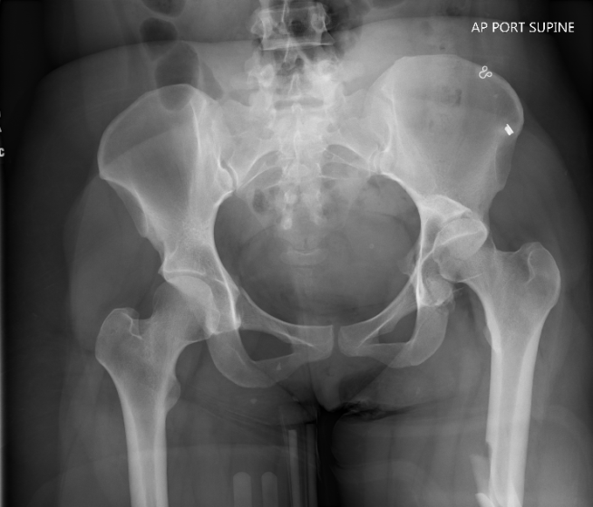
Case 4
Notes:
Posterior left hip dislocation
Left posterior wall acetabular fracture
Communited left femoral diaphysis fracture
- Posterior hip dislocations are much more common the anterior hip dislocations (90%).
- A common mechanism of injury is the so-called dashboard injury in an MVC, where a the knee strikes the dashboard in a seated position. The force is transmitted from the knee to the hip and pushes the femoral head out of socket posteriorly. The mechanism also frequently fractures the posterior wall of the acetabulum.
- It can be difficult to determine if a dislocation is anterior or posterior. Some clues to a posterior dislocation are an associated posterior wall acetabulum fracture, and a smaller head size relative to a normal (reduced) contralateral hip.

Slide 19
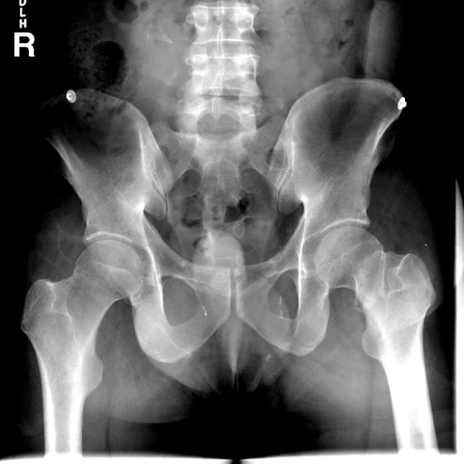
Case 5

Slide 20
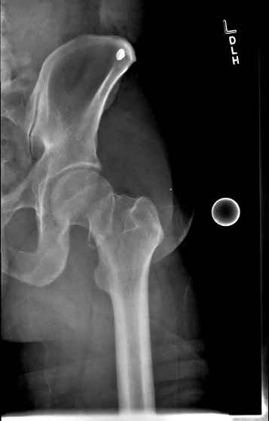

Slide 21
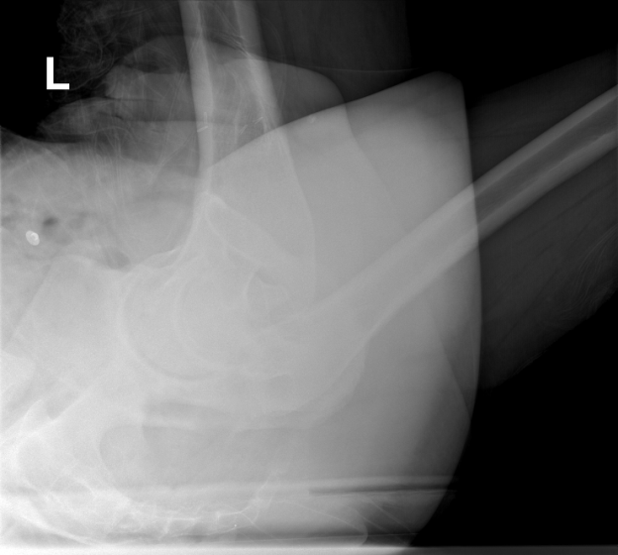
Notes:
Left subcapital femoral neck fracture
Right L3 and L4 transverse process fractures
Bilateral vasectomy clips
- Femoral neck fractures can be challenging to diagnose, especially in osteopenic bone which tends to compress instead of displace. Trace trabecular lines and look for interruptions.
- Primary fracture locations are subcapital (at the junction of the femoral head and neck), transcervical, and basicervical (at the base of the neck).
- 10-45% go on to develop osteonecrosis of the femoral head.

Slide 22
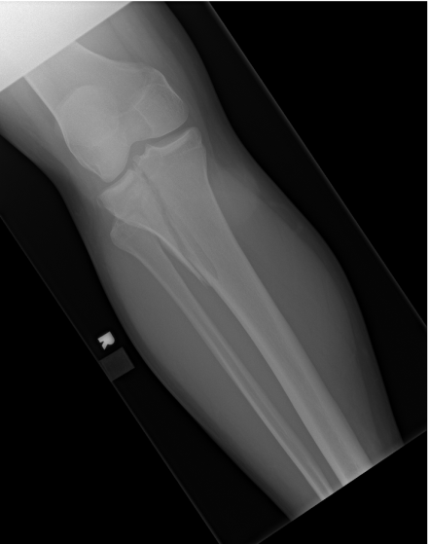
Case 6

Slide 23
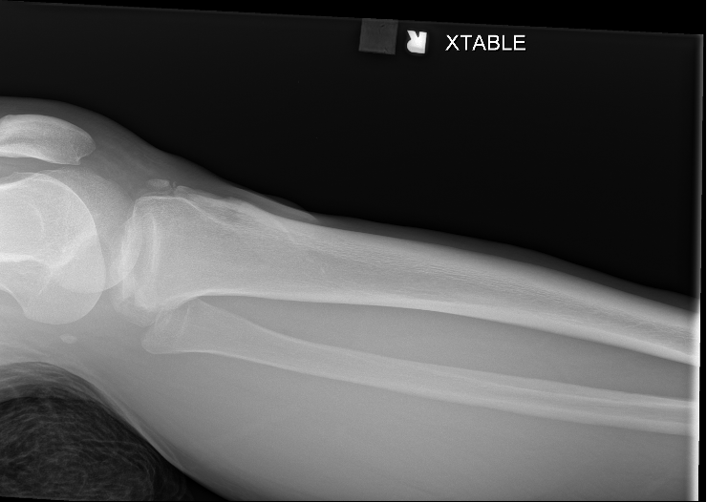
Notes:
Tibial plateau fracture, lateral condyle split (Schatzker Type I)
- Tibial plateau fractures occur from axial loading forces across the knee.
- The Schatzker classification system is used. In general, the higher the number, the more severe/debilitating the injury.
- For subtle fractures, especially depression-types, look for a lipohemarthrosis on lateral plain films, CT, or arthrocentesis. Its presence is pathognomonic for an intraarticular fracture, though not necessarily a tibial plateau fracture.

Slide 24
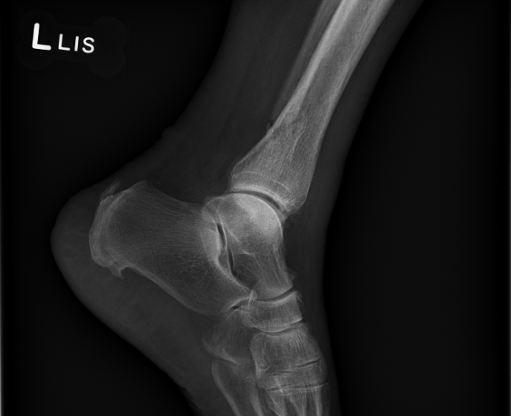
Case 7

Slide 25
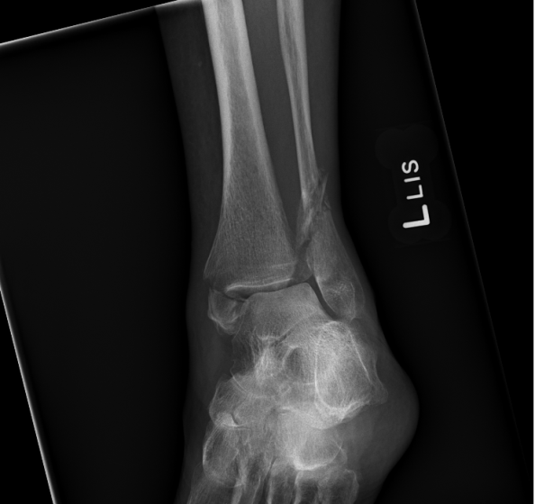
Notes:
Medial malleolus fracture
Oblique distal fibula fracture (Weber C)
Calcaneal enthesopathy
- A malleolus is a bony projection with a shape likened to a hammer/mallet head.
- There are three malleoli around the ankle: medial, lateral, and posterior
- A bimalleolar fracture involves two of the three malleoli, typically the medial and lateral.
- A trimalleolar fracture includes the posterior malleolus. This fracture is usually only seen on the lateral projection. It can also be obscured by the overlapping fibula.
- The Lauge-Hansen classification system describes “ankle” fractures by mechanism of injury. The first part is the position the foot started: Supination (S) or Pronation (P). The second part is the direction of applied force: External Rotation (ER), Abduction (AB), and Adduction (AD). The third part is a roman numeral indicating severity.
- Deducing the foot position (S/P) by plain films is a matter of assessing fracture morphology. Transverse fractures are tension fractures. Oblique fractures are sheer fractures or spiral/rotational fractures.
- In this case, the transverse fracture on the medial side, which means the foot position was pronated (P). The fibula fracture is oblique, not spiral, meaning the direction of applied force was straight (AB) and not rotational (ER). So this fracture is a PAB III.

Slide 26
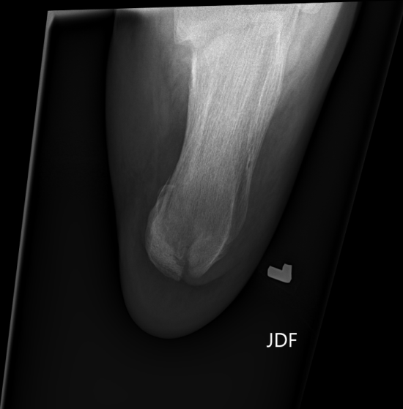
Case 8

Slide 27
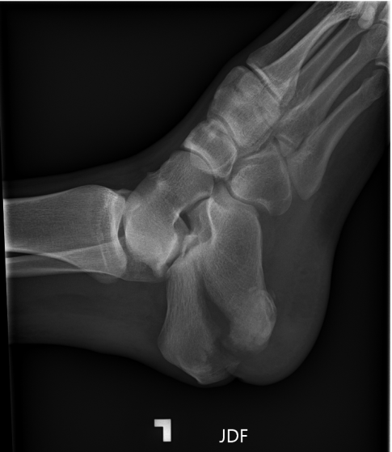
Notes:
Intraarticular fracture of the calcaneus with superior displacement of the superior fragment.
Posterior laceration/skinfold raises concern for an open fracture
- Calcaneus fractures are due to axial loading injuries, such as a fall from height and landing upright.
- The calcaneus breaks in predictable patterns, which are described by the number of fragments involving the posterior facet (Sanders classification).
- A particularly worrisome pattern is the so-called tongue-type pattern, which is shown here. This is due to the deforming force of the achilles tendon on a large longitudinally oriented fragment. The superiorly displaced fragment puts constant pressure on the overlying skin, potentially leading to skin-breakdown, and creation of an open fracture.

Slide 28
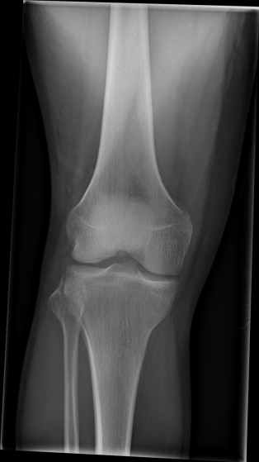
Case 9

Slide 29
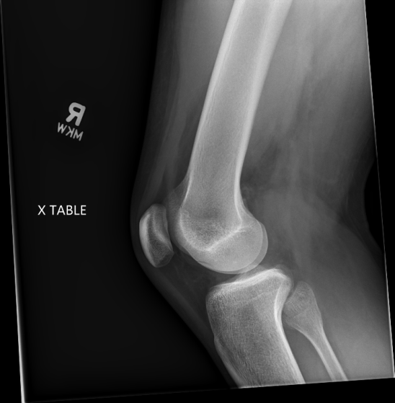

Slide 30
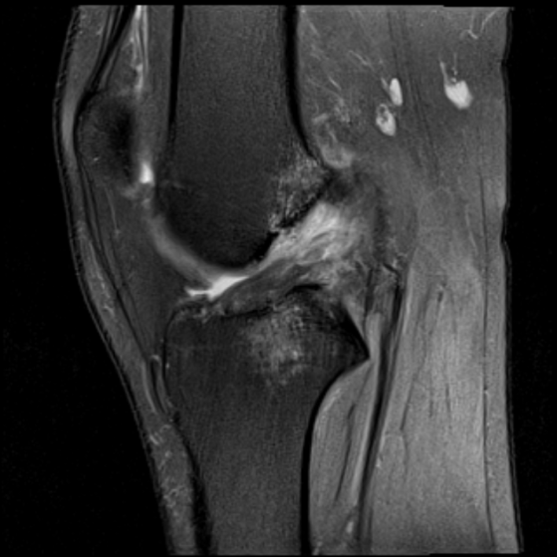
Notes:
Plain film: Curvilinear fracture fragment along the lateral tibial plateau adjacent to the fibular head. Osteochondral fracture of the lateral femoral condyle. Small joint effusion.
MRI: Complete tear of the ACL. Lateral femoral condyle osteochondral fracture. Coup and contrecoup bone contusions of the distal femur and proximal tibia (kissing lesions). MCL sprain. Intact PCL. Small joint effusion.
- Segond fracture is pathognomonic for an ACL tear. Due to avulsion of the anterolateral ligament (ALL).
- The ACL restricts anterior displacement of the tibia relative to the femur. Think of the femur as a dog-walker, the tibia is the dog, and the ACL is the leash keeping the dog from running away. When the ACL tears, the tibia frequently violently subluxes anteriorly and the posterior tibia collides with the distal femur as it reduces. This causes a characteristic pattern of bone contusions called “kissing” lesions/contusions. In this case, the contact was forceful enough to cause a fracture of the lateral femoral condyle.
- Ligaments are relatively hydrogen-poor, so they appear dark on most MRI sequences. When a ligament is injured, not only can the fibers appear disrupted, but the signal will increase due to water/edema influx. Compare how the native PCL looks relative to the injured ACL.

Slide 31
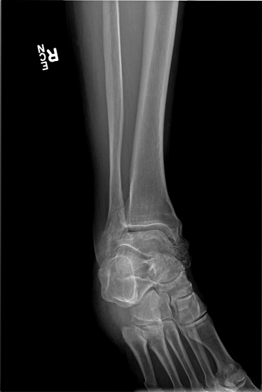
Case 10

Slide 32
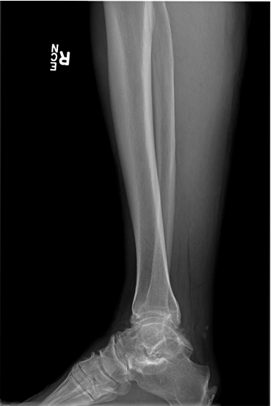

Slide 33
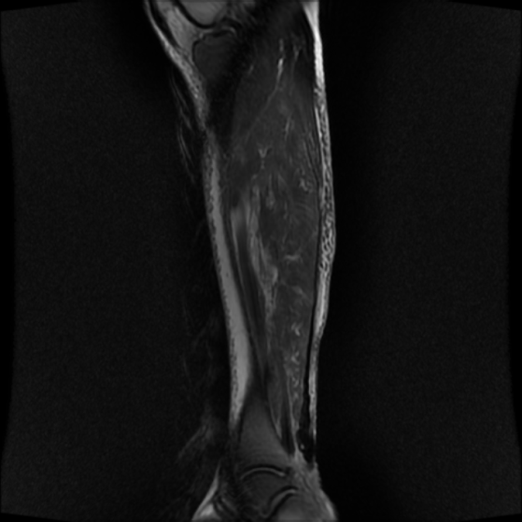
Notes:
Plain film: No acute findings. Polyarticular degenerative changes. Calcaneal enthesopathy.
MRI: Complete rupture of the distal achilles tendon with retraction. Mild reactive edema of the gastrocnemius/solues musculature and subcutaneous tissue.
- Classic history is a “weekend warrior” playing basketball/tennis/racquetball who describes being struck/shot in the back of the leg, followed by an inability to walk.
- There is frequently high clinical suspicion prior to imaging due to characteristic physical exam findings, including a palpable gap in the expected location of the achilles tendon, absence of passive plantarflexion with provocative squeeze of the calf musculature, and weak/absent active plantarflexion.
- Plain films are acquired to rule out associated pathology/fractures, but are not diagnostic for achilles tendon ruptures.
- MRI is the imaging modality of choice, even when the physical exam is diagnostic. It is important to evaluate completeness of the tear, degree of retraction, and concomitant injuries.

Slide 34
Cases
Anterior shoulder dislocation (1)
Distal radius fracture (6)
Boxer’s fracture (10)
Posterior hip dislocation (14)
Femoral neck fracture (15)
Tibial plateau fracture (18)
Bimalleolar ankle fracture (19)
Calcaneus fracture (20)
ACL tear (23)
Achilles tendon rupture (26)

Slide 35
Pet Peeves
“Hip fracture”
  The “hip” is a joint. You don’t fracture a joint, you fracture a bone.
  Say proximal femur fracture, femoral head fracture, etc.
“1st finger”
  It is confusing to patients and other providers to number the digits. The accepted terminology is Thumb, Index, Long, Ring, and Small fingers.

