Slide 1
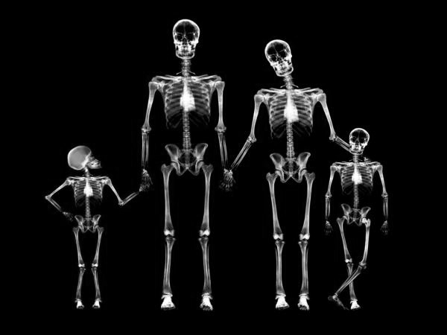
Populations

Slide 2

Notes:
Join instructions
https://www.polleverywhere.com/join_instructions

Slide 3
A patient presents with right hip pain. What is your differential diagnosis?

Slide 4
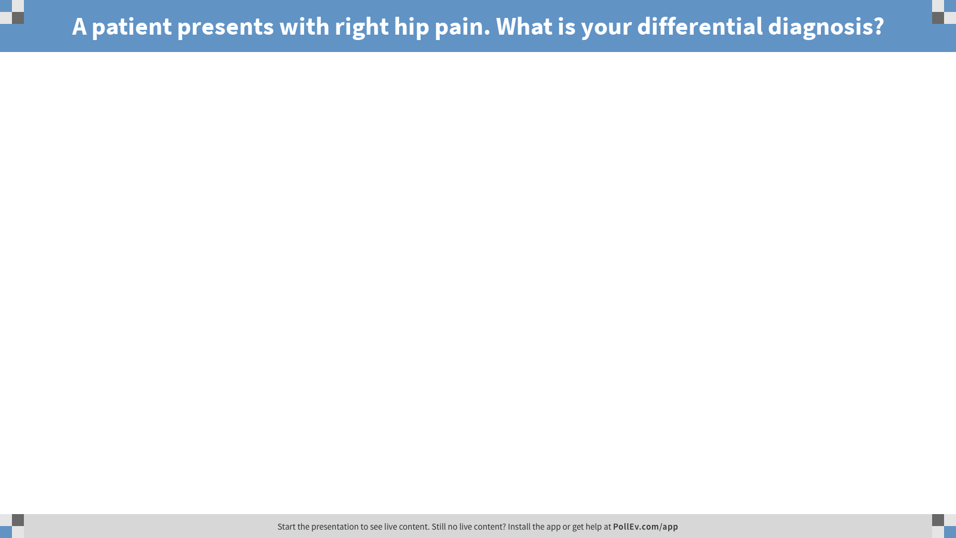
Notes:
A patient presents with right hip pain. What is your differential diagnosis?
https://www.polleverywhere.com/free_text_polls/TXWXylo8HVPUEVoK9rfaU
Fracture
Septic arthritis
Slipped Capital Femoral Epiphysis (SCFE)
Osteoarthritis
Hip dysplasia
Hip dislocation
Transient synovitis
Legg-Calve-Perthes Disease
Etc.

Slide 5
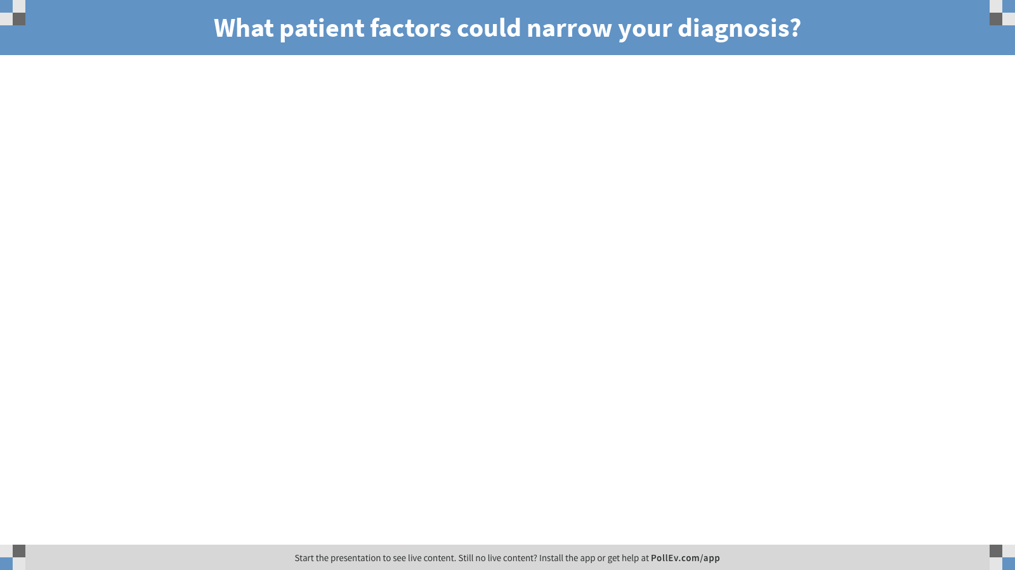
Notes:
What patient factors could narrow your diagnosis?
https://www.polleverywhere.com/free_text_polls/d2WgvQbrXp9SYTK1leKvb
Age, sex, ancestry, etc.

Slide 6
Activity
Divide into small groups
Organize the following hip radiographs chronologically by age from youngest to oldest

Slide 7
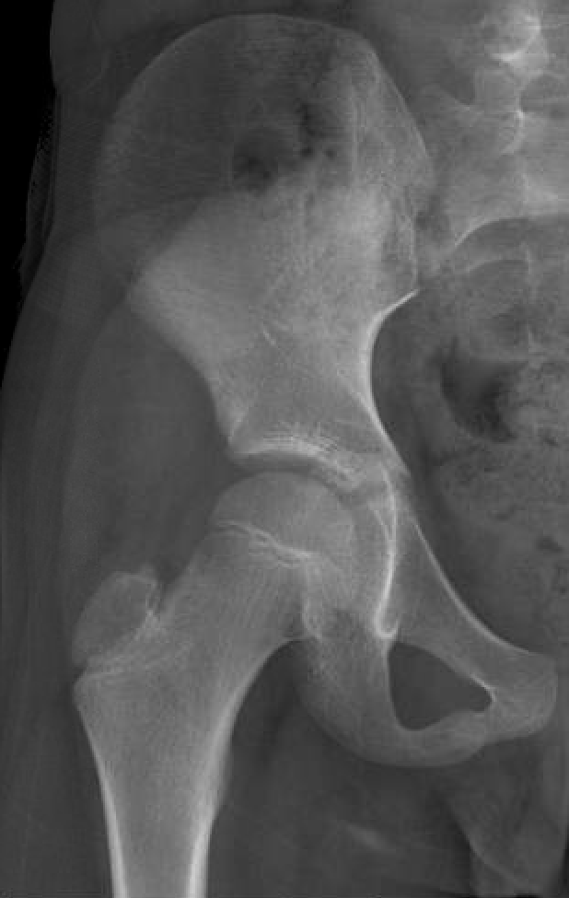
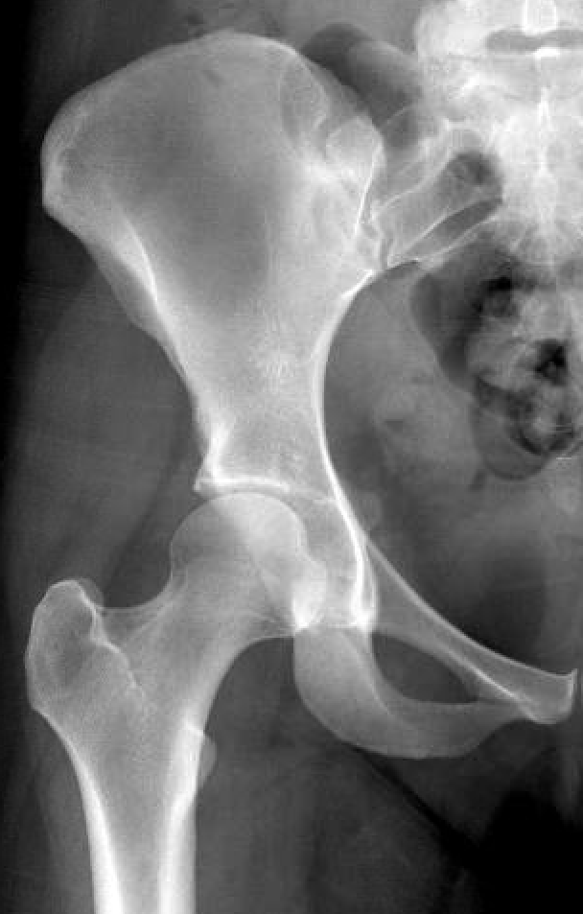
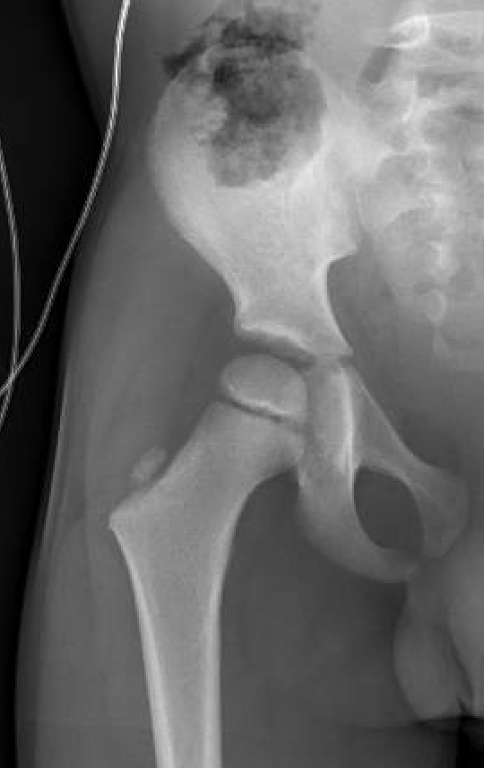
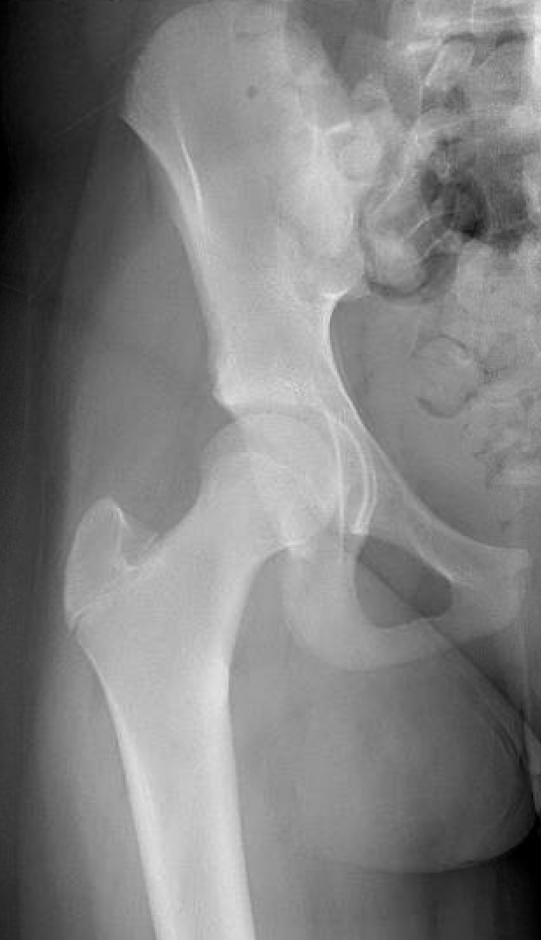
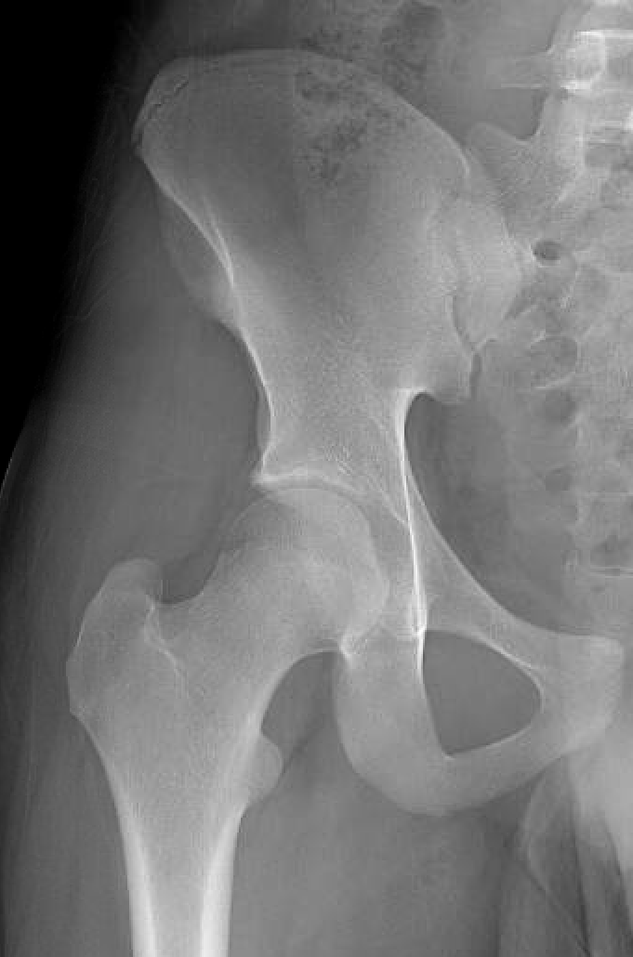
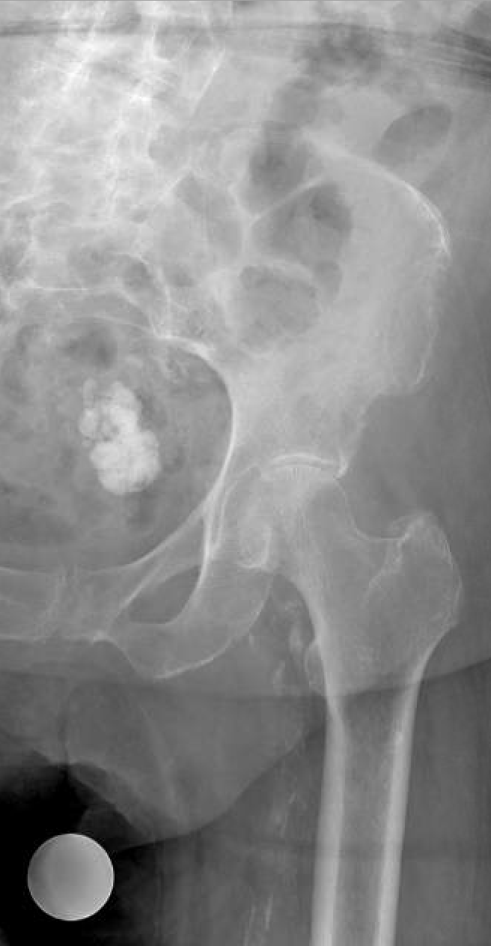
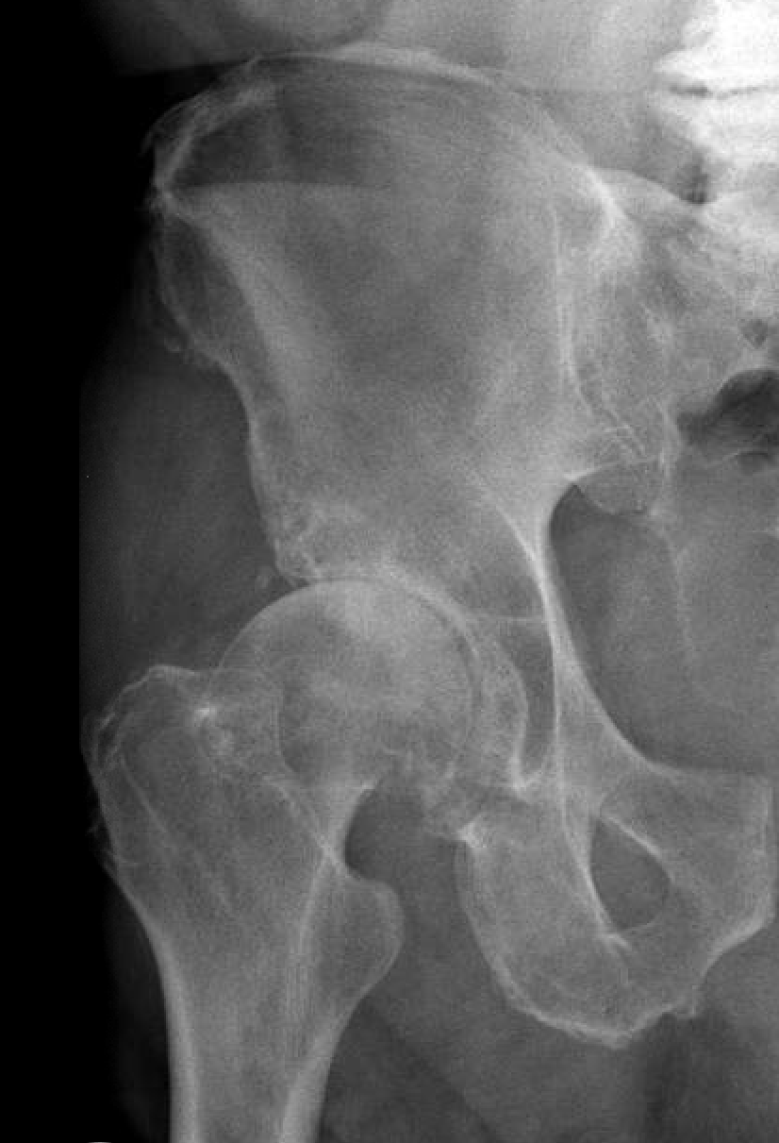
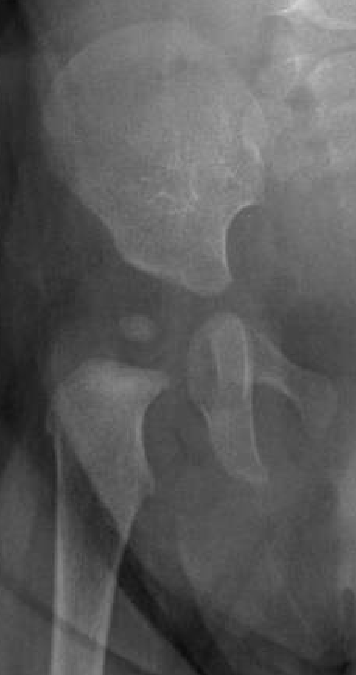
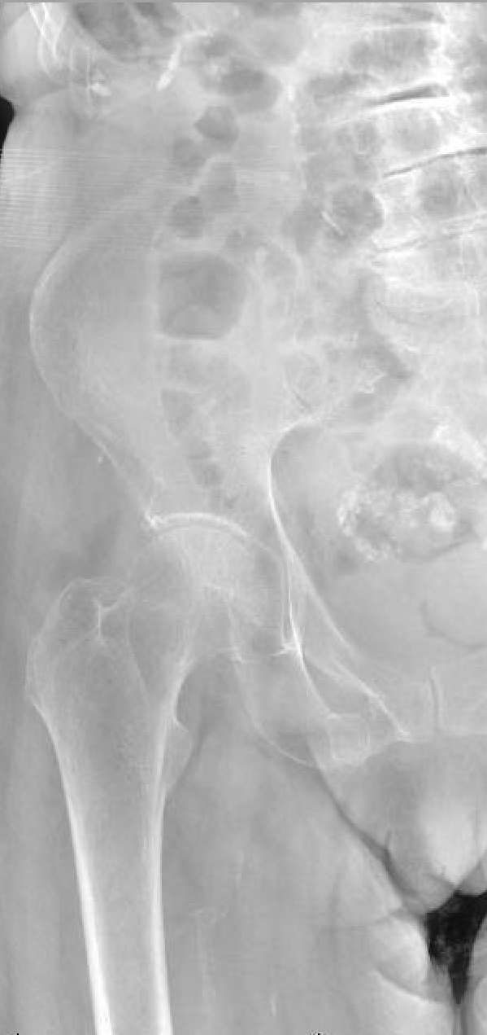
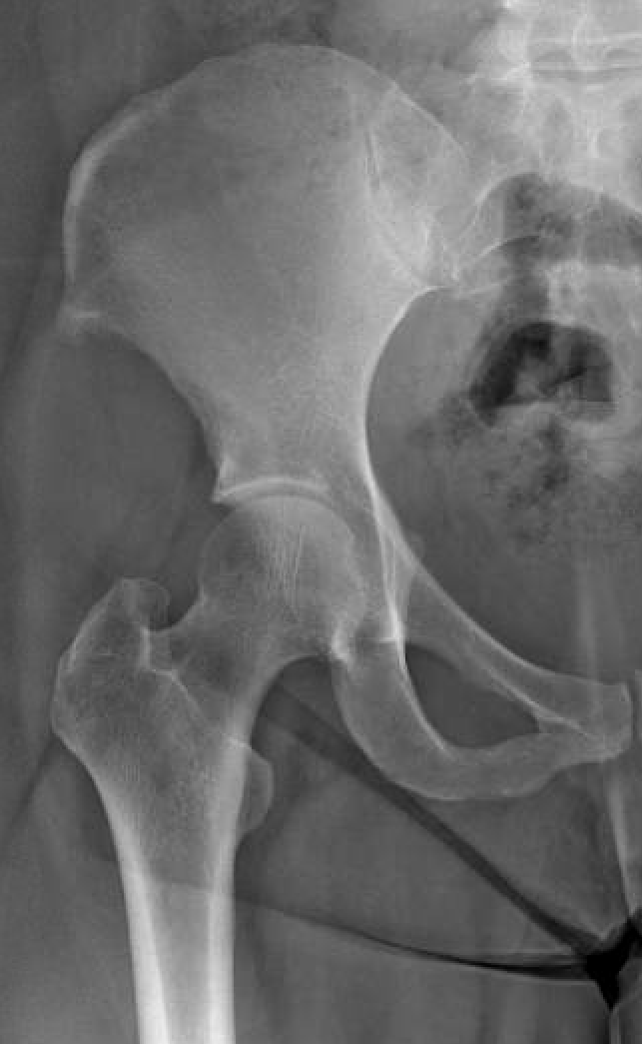
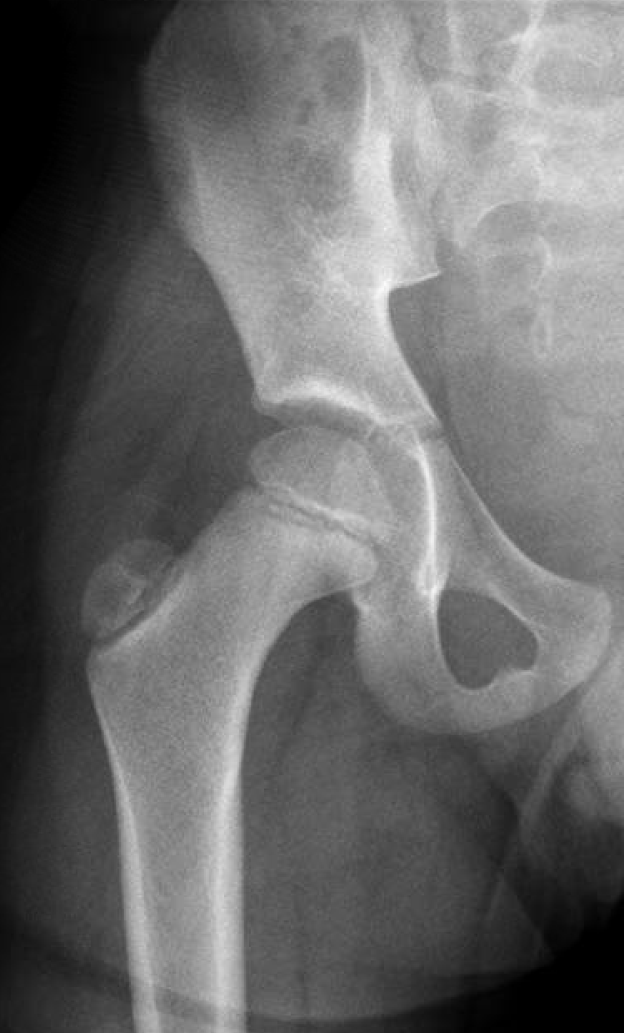
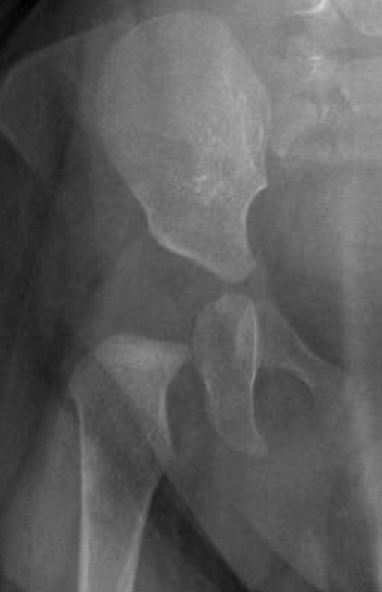
A
B
C
D
E
F
G
H
I
J
K
L
Notes:
L – 6 months
H – 7 months
C – 5 years
K – 6 years
A – 10 years
D – 13 years
E – 17 years
B – 23 years
J – 43 years
G – 77 years
F – 92 years
I – 105 years

Slide 8
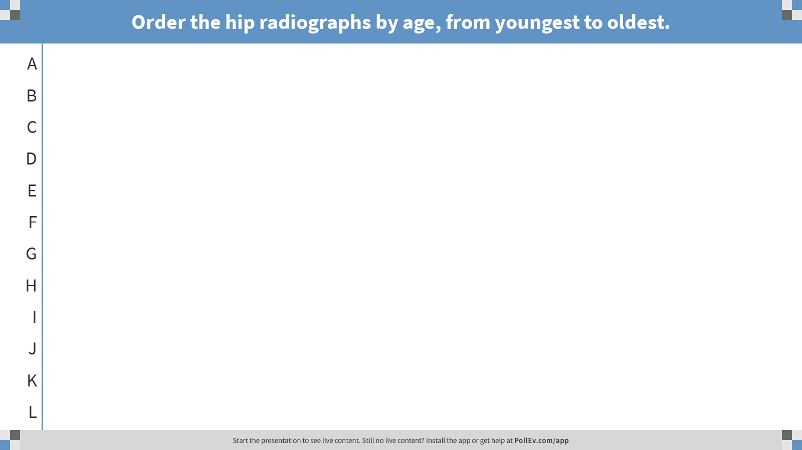
Notes:
Order the hip radiographs by age, from youngest to oldest.
https://www.polleverywhere.com/ranking_polls/0DRRDN3UaNdidyCtfzzaS
L – 6 months
H – 7 months
C – 5 years
K – 6 years
A – 10 years
D – 13 years
E – 17 years
B – 23 years
J – 43 years
G – 77 years
F – 92 years
I – 105 years

Slide 9

Activity - Debrief
What factors were used to make your decisions?
L – 6 months
H – 7 months
C – 5 years
K – 6 years
A – 10 years
D – 13 years
E – 17 years
B – 23 years
J – 43 years
G – 77 years
F – 92 years
I – 105 years
Notes:
Review over the correct sequence and discuss mistakes
Each group should present 1-2 factors they used to determine age radiographically

Slide 10
Age is just a number…
Why does grouping populations by age matter?

Slide 11
Recall the first question:
  A patient presents with right hip pain.
  What is your differential diagnosis?
Which of the differential diagnoses can occur in any group?
  Why?
Are there certain patterns you might expect in one age group over another?
Notes:
Femoral neck fracture in an elderly with low energy trauma vs intertroch fracture in a young adult with high energy trauma

Slide 12
Let’s mix it up…
A year old patient presents with right hip pain. What is your favored diagnosis and what imaging study should you order?
2
Notes:
Septic arthritis – Point to the pathology

Slide 13
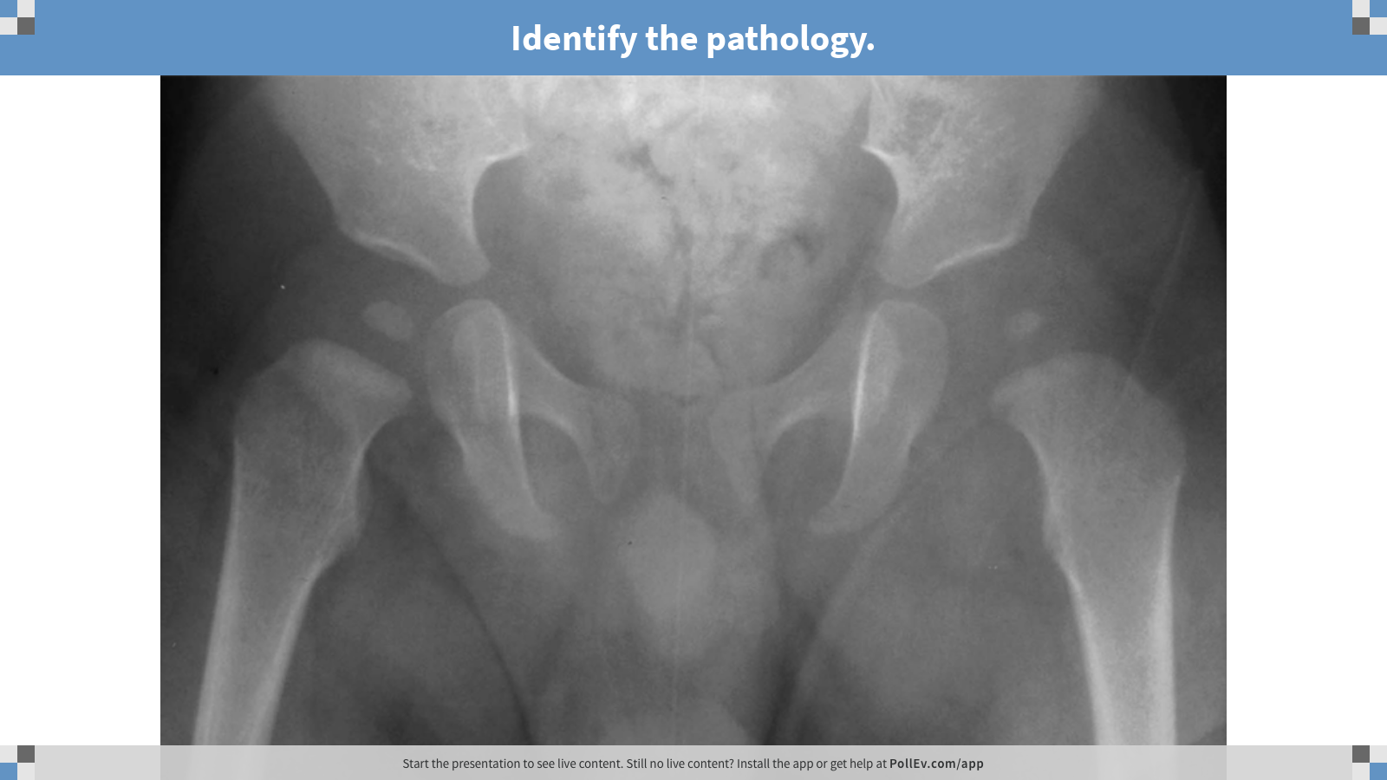
Notes:
Identify the pathology.
https://www.polleverywhere.com/clickable_images/EIQQUHi8OuQ3Lk8UPixvE
Septic Arthritis
Even though the prompt said the pain was on the right, the widening of the joint space is on the left. 2 years are notoriously unreliable historians.
Transphyseal vessels in neonates allow for transient bacteremia to seed joints.

Slide 14
A year old patient presents with right hip pain. What is your favored diagnosis and what imaging study should you order?
6
Notes:
Transient Synovitis – Point to the pathology

Slide 15
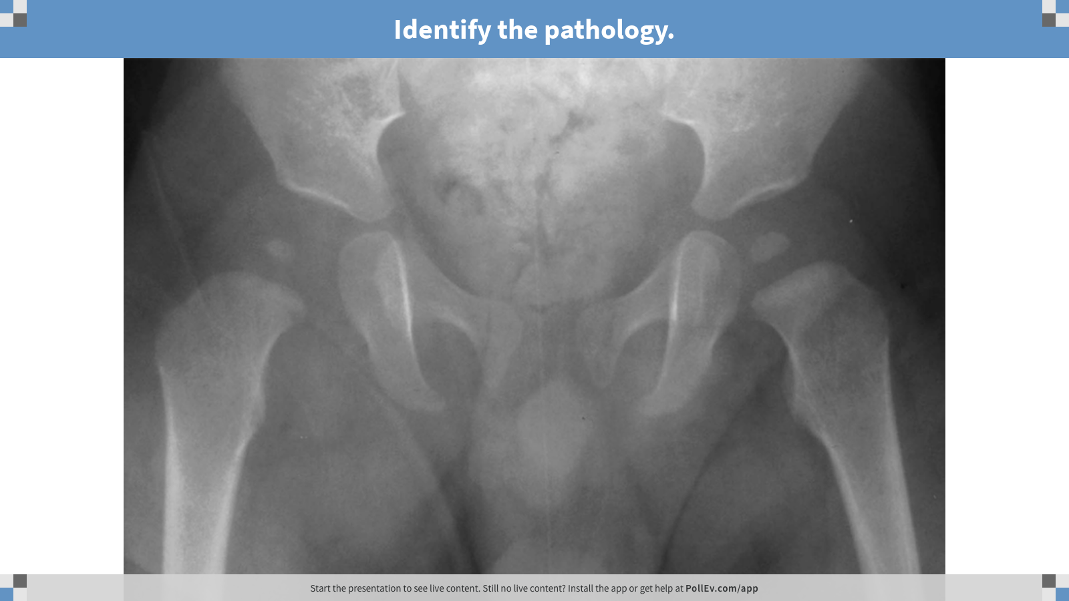
Notes:
Identify the pathology.
https://www.polleverywhere.com/clickable_images/Oo45oRGklK9Y1nKuSrMRj
Transient Synovitis: inflammation of the joint space, classically following a URI, with a benign clinical course

Slide 16
Septic Arthritis vs Transient Synovitis
Kocher Criteria
Refusal to bear weight
Fever
ESR > 40 mm/hr
WBC > 12k
 | Chance Child has Septic Arthritis
4/4 | 99%
3/4 | 93%
2/4 | 40%
1/4 | 3%

Slide 17
A year old patient presents with right hip pain. What is your favored diagnosis and what imaging study should you order?
7
Notes:
Legg-Calve-Perthes – Point to the pathology

Slide 18
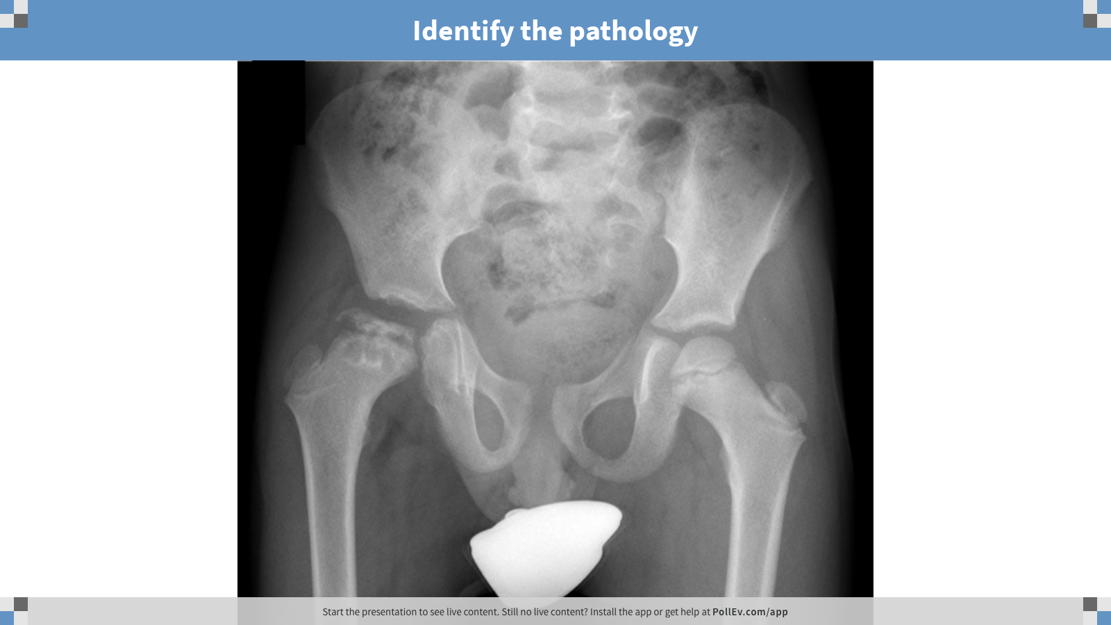
Notes:
Identify the pathology
https://www.polleverywhere.com/clickable_images/yHpF9rSx2lqAScMMIt77M
Legg-Calve-Perthes: Idiopathic osteonecrosis of the femoral epiphysis in children (diagnosis of exclusion)

Slide 19
A year old patient presents with right hip pain. What is your favored diagnosis and what imaging study should you order?
12
Notes:
Slipped Capital Femoral Epiphysis– Point to the pathology

Slide 20
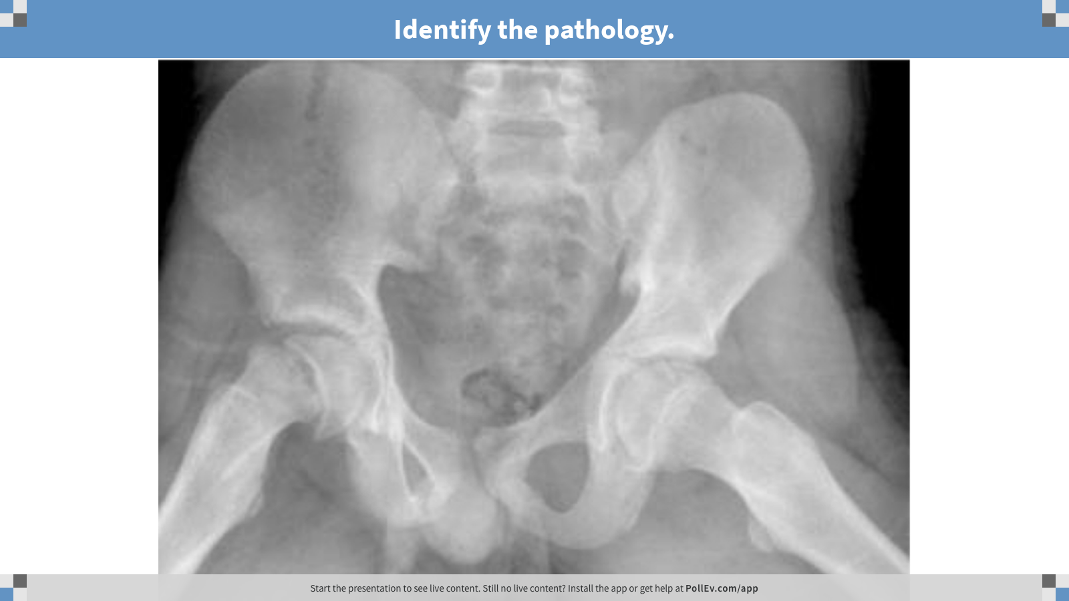
Notes:
Identify the pathology.
https://www.polleverywhere.com/clickable_images/ROTVhmIHhcNa01ruTFCov

Slide 21
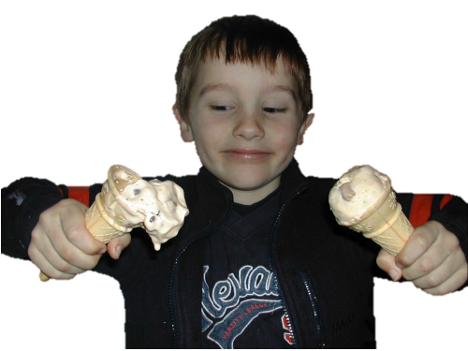
SCFE (“Skiff-ee”)

Slide 22
A year old patient presents with right hip pain. What is your favored diagnosis and what imaging study should you order?
25
Notes:
High energy fracture pattern

Slide 23
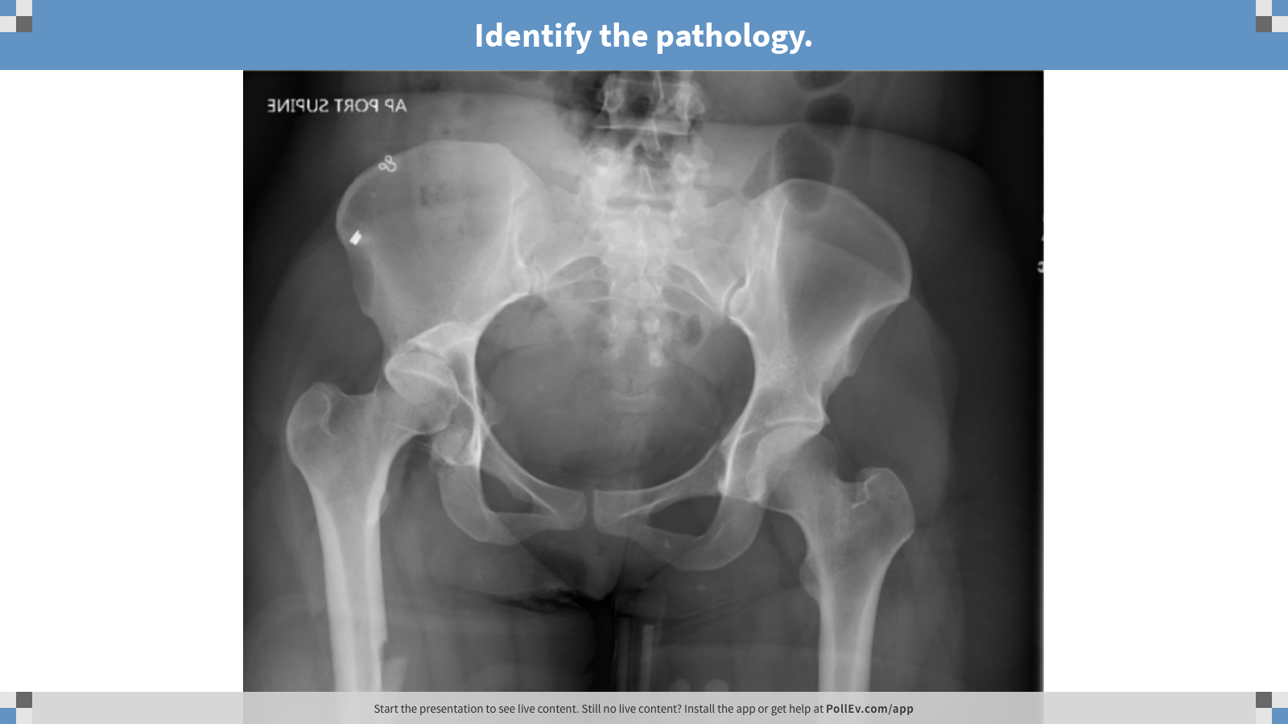
Notes:
Identify the pathology.
https://www.polleverywhere.com/clickable_images/CfAwVYpgyDn18oEznlnnE
Posterior hip dislocation.
Posterior wall acetabular fracture.
Femoral diaphyseal fracture.

Slide 24
A year old patient presents with right hip pain. What is your favored diagnosis and what imaging study should you order?
75
Notes:
Low energy fracture pattern

Slide 25
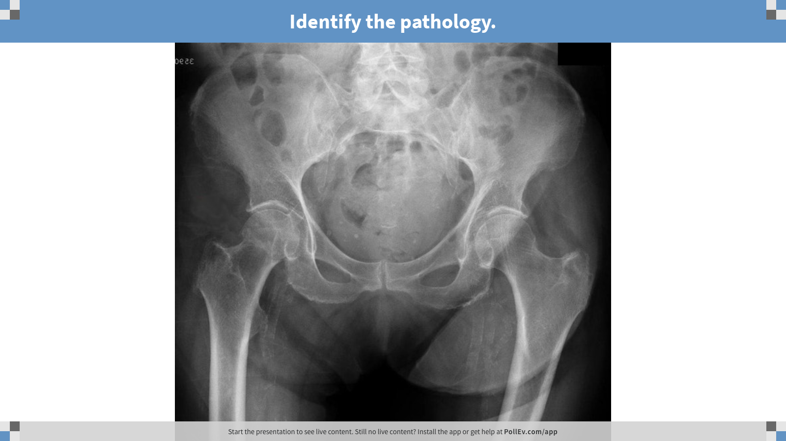
Notes:
Identify the pathology.
https://www.polleverywhere.com/clickable_images/J8vBYY616VRSou8UuVnVM
Femoral Neck Fracture

Slide 26
Chronogram
Legg-Calve-Perthes
Transient Synovitis
High Energy Trauma
Slipped Capital Femoral Epiphysis (SCFE)
Septic Arthritis
Low Energy Trauma
1 2 3 4 5 6 7 8 9 10 11 12 13 14 15 16 17 18 19 20…30…40…50…60…70…80…90

Slide 27
Other populations?
What if this patient is diabetic?
What if this patient has AVN?
Immunocompromised?
Race?
Others…?

